Slide 1
Module-4
Robot Coordinate Systems- Fundamental and composite rotations, homogeneous co-ordinates and transformations, Kinematic parameters, D-H representation, Direct Kinematics. The Arm equation forward Kinematic analysis of a typical robots upto 3 DOF.
Motion Planning- joint space trajectory planning-cubic polynomial, linear trajectory with parabolic blends; Cartesian space planning, Point to point vs continuous path planning.

Slide 2
Introduction
In the analysis of manipulators the location of links, joints, and end effectors in the 3D space need to be continuously monitored.
To describe the position and orientation of a body in space, a frame is attached the body.
The position and orientation of this frame with respect to the reference coordinate frame, called base frame, mathematically describes the location of the body.

Slide 3
Coordinate frame

Slide 4
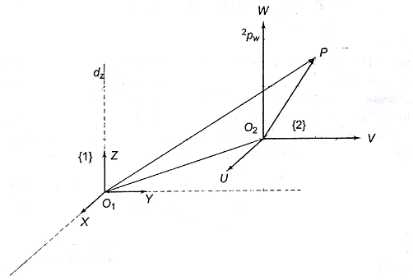
Coordinate frame
Often the description of a body in one frame is known while requirement is the description of the body with respect to another frame. This requires mapping or transforming or changing the description of its attributes from one frame to another.
We have 2 frames 1(XYZ) and 2(UVW). Description of point P with respect to UVW ordinates is known and mapping or transformation is required to represent the system with respect to XYZ ordinates

Slide 5
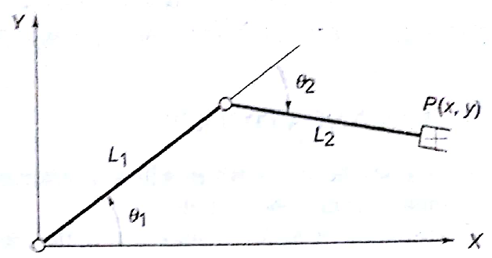
Forward Kinematics
The basic problem in study of mechanical manipulator is of computing the position and orientation of end effector of the manipulator when the joint angles are known. This is referred to as forward kinematics.
That is the Link length (L1, L2) and joint angles (θ₁, θ₂ ) are know and we need to calculate the position and orientation of end tool.

Slide 6
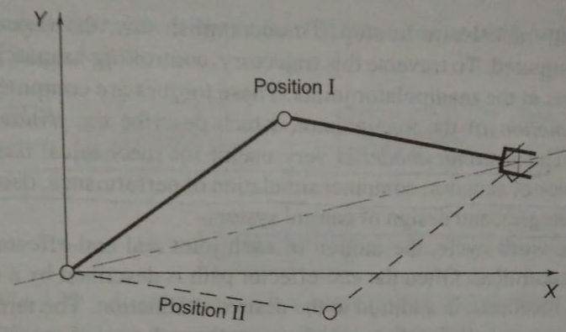
Inverse Kinematics
The inverse kinematics problem is to determine the joint angle given the position and orientation of the end effector.
The problem that can be faced in inverse kinematics is that the solution for joint angle may not be unique, there may be multiple solutions.
That is position and orientation of the XYZ plane is known we need to calculate the joint angles (θ₁, θ₂ ) (Link length (L1, L2) will be fixed for a manipulator)

Slide 7
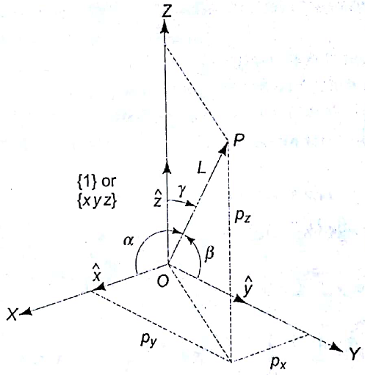
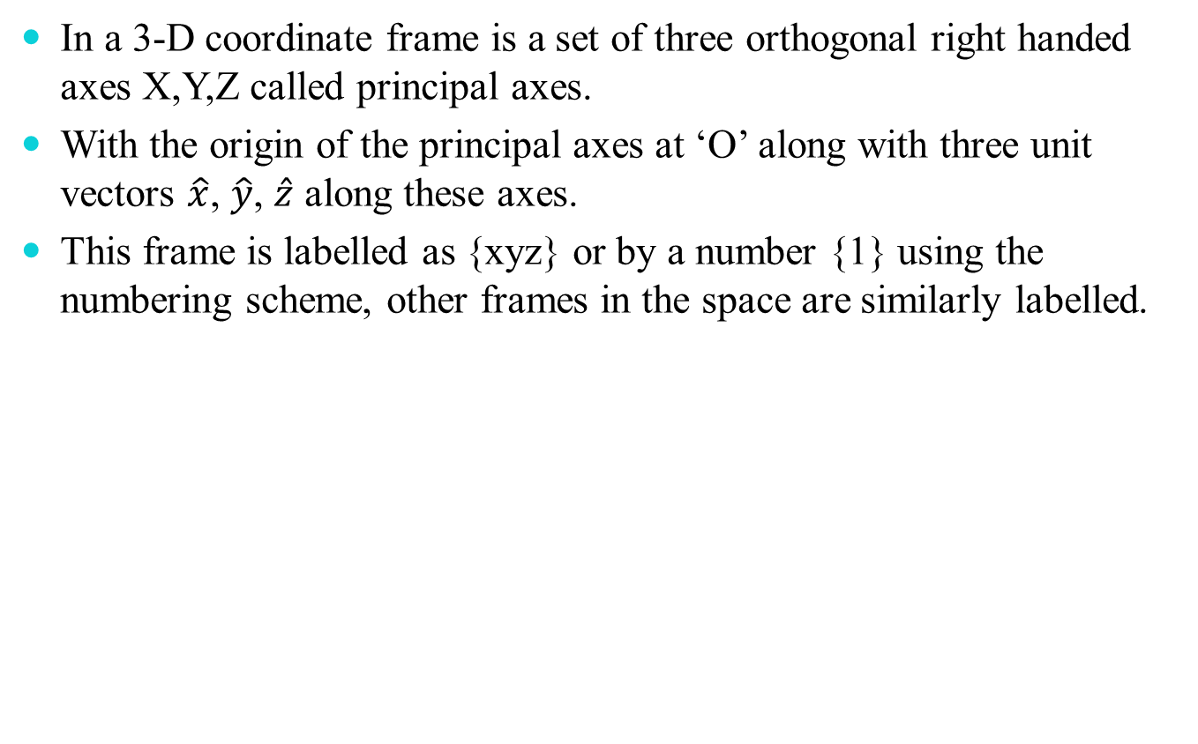
Coordinate frame
In a 3-D coordinate frame is a set of three orthogonal right handed axes X,Y,Z called principal axes.
With the origin of the principal axes at ‘O’ along with three unit vectors $\hat{x}$, $\hat{y}$, $\hat{z}$ along these axes.
This frame is labelled as {xyz} or by a number {1} using the numbering scheme, other frames in the space are similarly labelled.

Slide 8
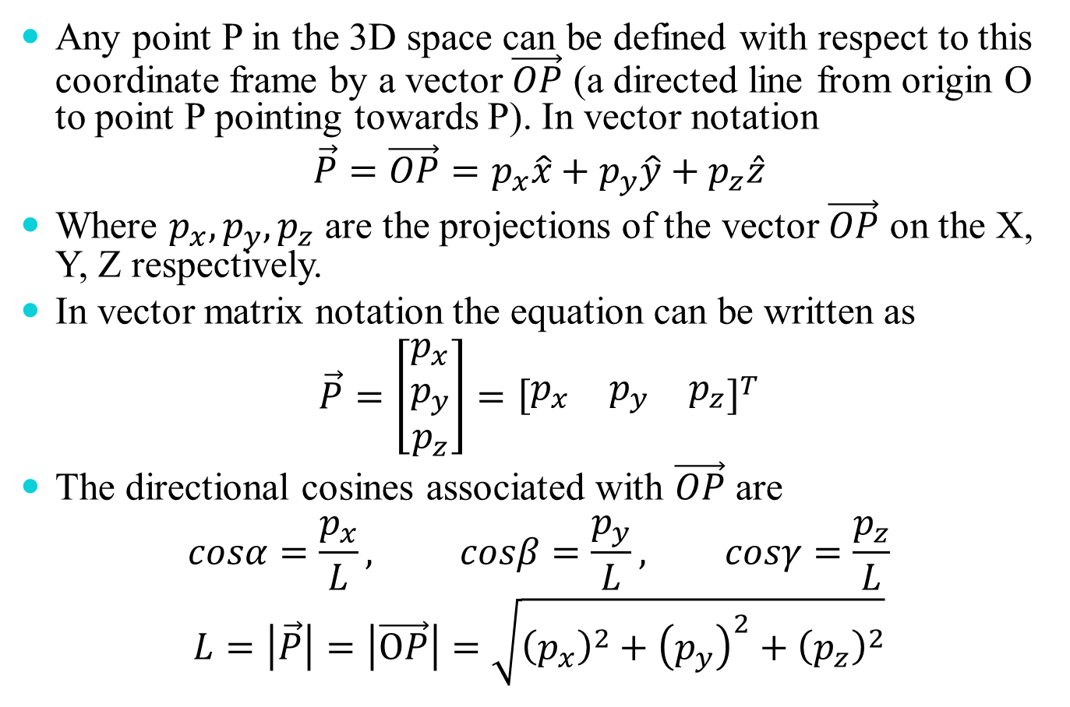
Any point P in the 3D space can be defined with respect to this coordinate frame by a vector $\vec{OP}$ (a directed line from origin O to point P pointing towards P). In vector notation
$$\vec{P}=\vec{OP}=p_{x}\hat{x}+p_{y}\hat{y}+p_{z}\hat{z}$$
Where $p_{x},p_{y},p_{z}$ are the projections of the vector $\vec{OP}$ on the X, Y, Z respectively.
In vector matrix notation the equation can be written as
$$\vec{P}=\left[\begin{matrix}p_{x} \\ p_{y} \\ p_{z}\end{matrix}\right]={\left[\begin{matrix}p_{x} & p_{y} & p_{z}\end{matrix}\right]}^{T}$$
The directional cosines associated with $\vec{OP}$ are
$$cosα=\frac{p_{x}}{L}, cosβ=\frac{p_{y}}{L}, cosγ=\frac{p_{z}}{L}$$
$$L=\left|\vec{P}\right|=\left|\vec{OP}\right|=\sqrt{{\left(p_{x}\right)}^{2}+{\left(p_{y}\right)}^{2}+{\left(p_{z}\right)}^{2}}$$

Slide 9
Mapping
Mapping refers to changing the description of a point in space from one frame to another. There are three possible changes.
Second frame is rotated with respect to the first frame. Origin of both frame is the same. In robotics its referred as change in orientation.
Second frame is moved away from the first. Axis of both frames remains parallel. This referred as translation of origin.
Second frame is rotated and moved away from the first frame. The second frame is translated and its orientation is also changed.

Slide 10
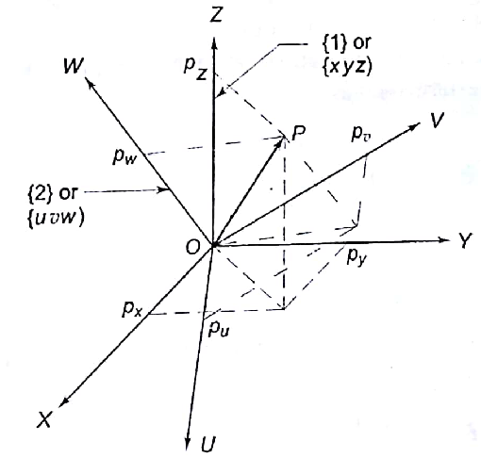
Mapping between rotated frames
Consider the two frames frame{1} with axes X, Y, Z and frame {2} with axes U, V, W with common origin.

Slide 11
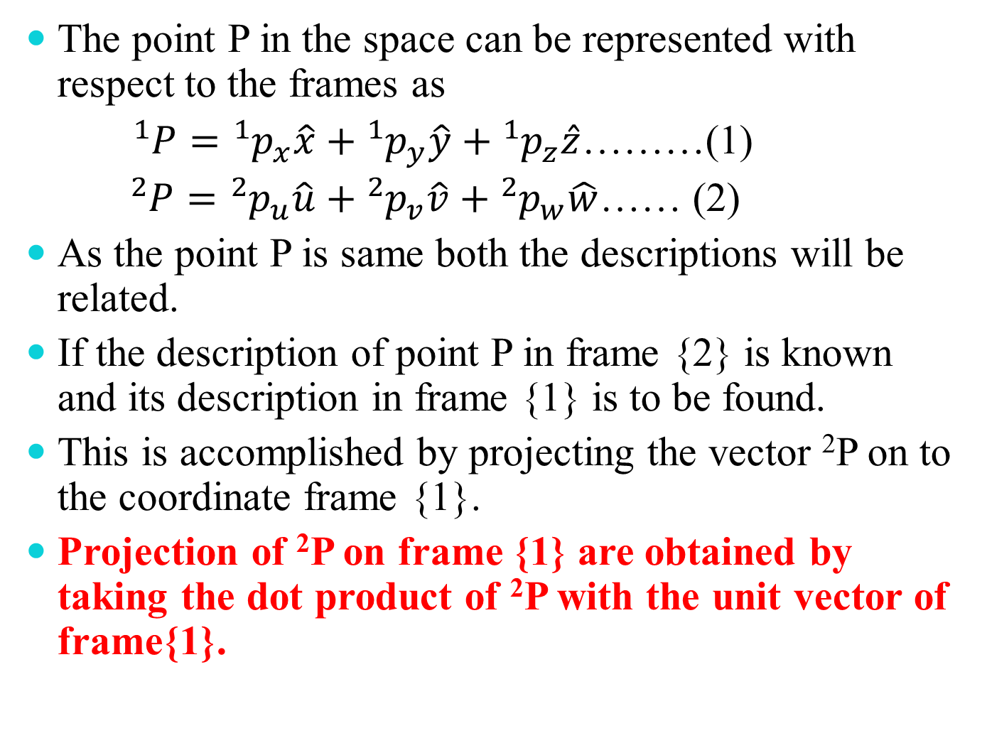
The point P in the space can be represented with respect to the frames as
${}_{}^{1}P={}_{}^{1}{p_{x}}\hat{x}+{}_{}^{1}{p_{y}}\hat{y}+{}_{}^{1}{p_{z}}\hat{z}$………(1)
${}_{}^{2}P={}_{}^{2}{p_{u}}\hat{u}+{}_{}^{2}{p_{v}}\hat{v}+{}_{}^{2}{p_{w}}\hat{w}$…… (2)
As the point P is same both the descriptions will be related.
If the description of point P in frame {2} is known and its description in frame {1} is to be found.
This is accomplished by projecting the vector ²P on to the coordinate frame {1}.
Projection of ²P on frame {1} are obtained by taking the dot product of ²P with the unit vector of frame{1}.

Slide 12
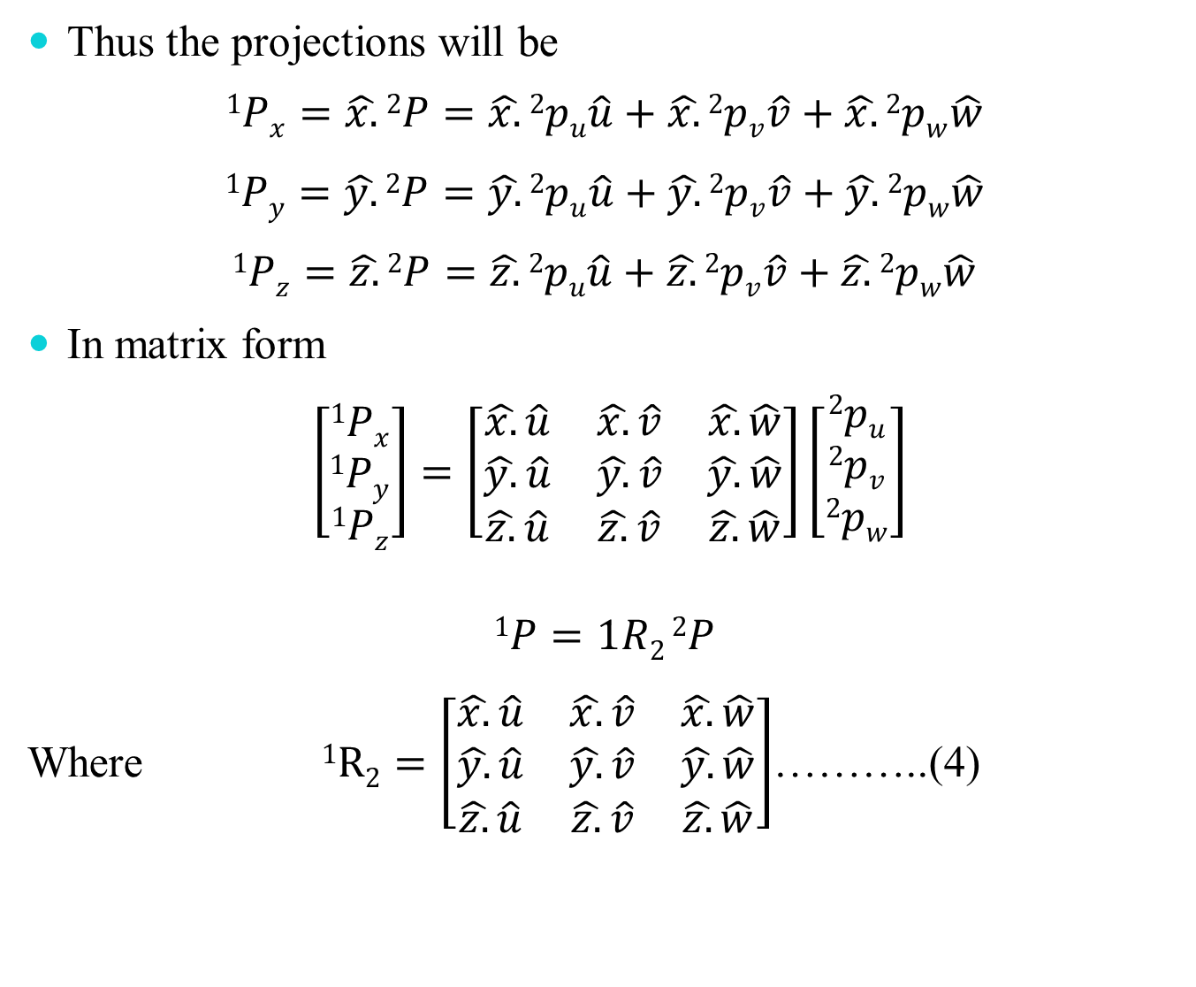
Thus the projections will be
$$1Px=\hat{x.}2P=\hat{x.}2pu\hat{u}+\hat{x.}2pv\hat{v}+\hat{x.}2pw\hat{w}$$
$$1Py=\hat{y.}2P=\hat{y.}2pu\hat{u}+\hat{y.}2pv\hat{v}+\hat{y.}2pw\hat{w}$$
$$1Pz=\hat{z.}2P=\hat{z.}2pu\hat{u}+\hat{z.}2pv\hat{v}+\hat{z.}2pw\hat{w}$$
In matrix form
$\left[\begin{matrix}1Px \\ 1Py \\ 1Pz\end{matrix}\right]=\left[\begin{matrix}\hat{x.}\hat{u} & \hat{x.}\hat{v} & \hat{x.}\hat{w} \\ \hat{y.}\hat{u} & \hat{y.}\hat{v} & \hat{y.}\hat{w} \\ \hat{z.}\hat{u} & \hat{z.}\hat{v} & \hat{z.}\hat{w}\end{matrix}\right]\left[\begin{matrix}2pu \\ 2pv \\ 2pw\end{matrix}\right]$
$$1P=1R2 2P$$
Where $1R2=\left[\begin{matrix}\hat{x.}\hat{u} & \hat{x.}\hat{v} & \hat{x.}\hat{w} \\ \hat{y.}\hat{u} & \hat{y.}\hat{v} & \hat{y.}\hat{w} \\ \hat{z.}\hat{u} & \hat{z.}\hat{v} & \hat{z.}\hat{w}\end{matrix}\right]$………..(4)

Slide 13
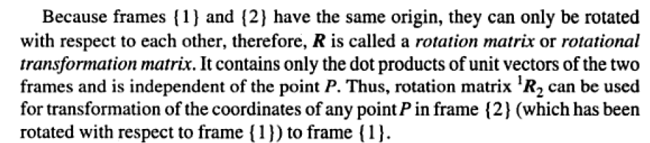
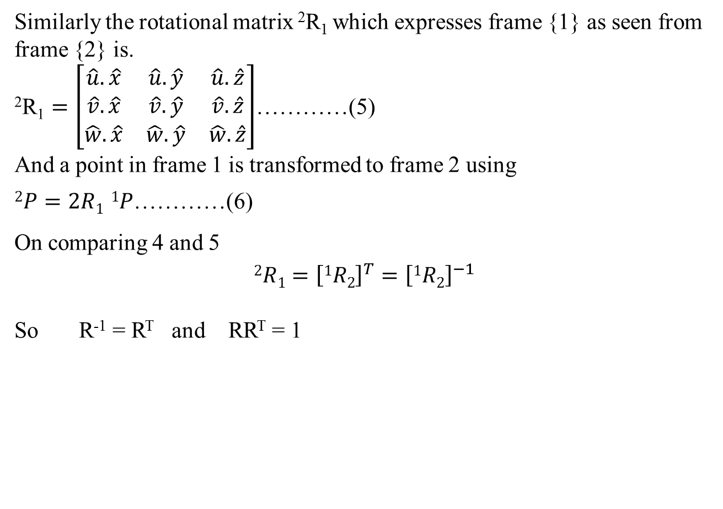
Similarly the rotational matrix ²R₁ which expresses frame {1} as seen from frame {2} is.
$\text{2}\text{R}\text{1}=\left[\begin{matrix}\hat{u}.\hat{x} & \hat{u}.\hat{y} & \hat{u}.\hat{z} \\ \hat{v}.\hat{x} & \hat{v}.\hat{y} & \hat{v}.\hat{z} \\ \hat{w}.\hat{x} & \hat{w}.\hat{y} & \hat{w}.\hat{z}\end{matrix}\right]$…………(5)
And a point in frame 1 is transformed to frame 2 using
$2P=2R1 1P$…………(6)
On comparing 4 and 5
$$2R1={\left[1R2\right]}^{T}={\left[1R2\right]}^{−1}$$
So R⁻¹ = R^{T} and RR^{T} = 1

Slide 14
Mapping between translated frame
Consider two frames {1} and frame {2} with origin O₁ and O₂ such that the axes of frame {1} are parallel to axes of frame {2}.

Slide 15
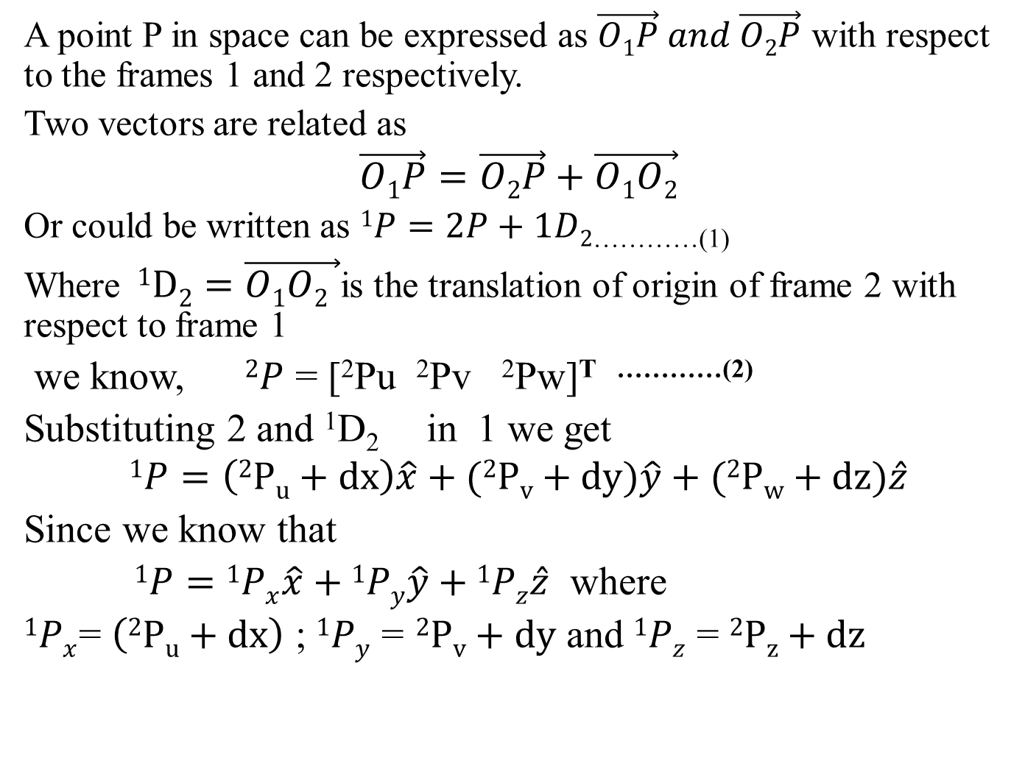
A point P in space can be expressed as $\vec{O1P} and \vec{O2P}$ with respect to the frames 1 and 2 respectively.
Two vectors are related as
$$\vec{O1P}=\vec{O2P}+\vec{O1O2}$$
Or could be written as $1P=2P+1D2$_{…………(1)}
Where $1D2=\vec{O1O2 }$is the translation of origin of frame 2 with respect to frame 1
we know, $2P$ = [²Pu ²Pv ²Pw]^{T …………(2)}
Substituting 2 and ¹D₂ in 1 we get
$$1P=\left(2Pu+dx\right)\hat{x}+(2Pv+dy)\hat{y}+(2Pw+dz)\hat{z}$$
Since we know that
$1P=1Px\hat{x}+1Py\hat{y}+1Pz\hat{z}$ where
$1Px$= $\left(2Pu+dx\right)$ ; $1Py$ =$2Pv+dy$ and $1Pz$ = $2Pz+dz$

Slide 16
In rotation, the origin of the two coordinate frames are the same. This invariance of the origin characteristics allows the representation of rotation in 3-D space as a 3 x 3 rotation matrix R.
In translation, the origin of the translated frame and original frame are not coincident and translation is represented by a 3 x 1 vector ¹D₂.

Slide 17
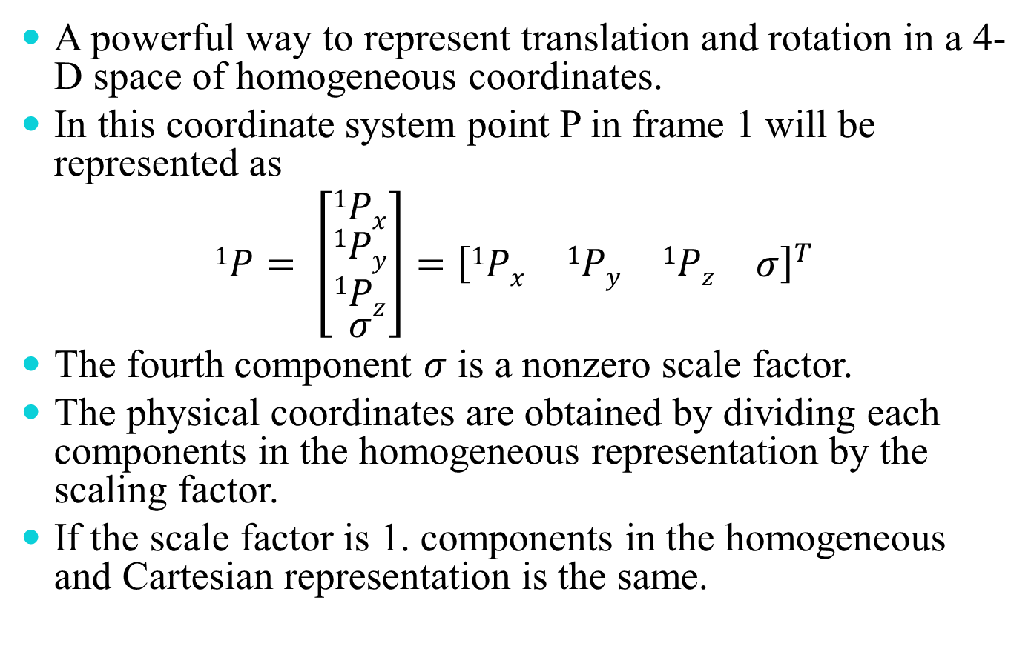
Homogeneous translation matrix
A powerful way to represent translation and rotation in a 4-D space of homogeneous coordinates.
In this coordinate system point P in frame 1 will be represented as
$$1P= \left[\begin{matrix}1Px \\ \begin{matrix}1Py \\ 1Pz\end{matrix} \\ σ\end{matrix}\right]={\left[\begin{matrix}1Px & \begin{matrix}1Py & 1Pz\end{matrix} & σ\end{matrix}\right]}^{T}$$
The fourth component $σ$ is a nonzero scale factor.
The physical coordinates are obtained by dividing each components in the homogeneous representation by the scaling factor.
If the scale factor is 1. components in the homogeneous and Cartesian representation is the same.

Slide 18
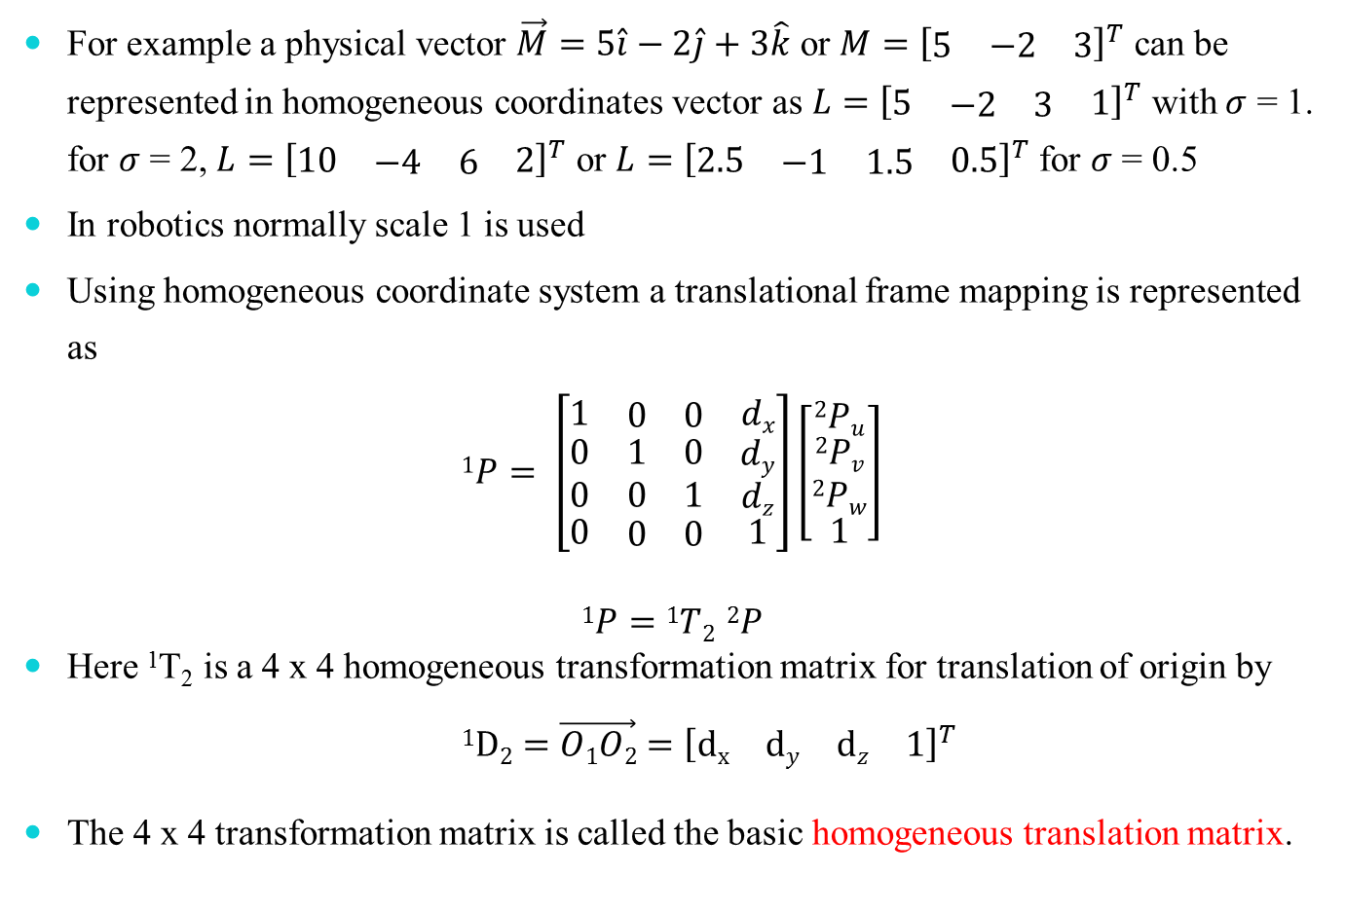
For example a physical vector $\vec{M}=5\hat{i}−2\hat{j}+3\hat{k}$ or $M={\left[\begin{matrix}5 & −2 & 3\end{matrix}\right]}^{T}$ can be represented in homogeneous coordinates vector as $L={\left[\begin{matrix}5 & \begin{matrix}−2 & 3\end{matrix} & 1\end{matrix}\right]}^{T}$ with $σ$ = 1. for $σ$ = 2, $L={\left[\begin{matrix}10 & \begin{matrix}−4 & 6\end{matrix} & 2\end{matrix}\right]}^{T}$ or $L={\left[\begin{matrix}2.5 & \begin{matrix}−1 & 1.5\end{matrix} & 0.5\end{matrix}\right]}^{T}$ for $σ$ = 0.5
In robotics normally scale 1 is used
Using homogeneous coordinate system a translational frame mapping is represented as
$$1P= \left[\begin{matrix}1 & \begin{matrix}0 & 0\end{matrix} & dx \\ \begin{matrix}0 \\ 0\end{matrix} & \begin{matrix}\begin{matrix}1 & 0\end{matrix} \\ \begin{matrix}0 & 1\end{matrix}\end{matrix} & \begin{matrix}dy \\ dz\end{matrix} \\ 0 & \begin{matrix}0 & 0\end{matrix} & 1\end{matrix}\right]\left[\begin{matrix}2Pu \\ \begin{matrix}2Pv \\ 2Pw\end{matrix} \\ 1\end{matrix}\right]$$
$$1P=1T2 2P$$
Here ¹T₂ is a 4 x 4 homogeneous transformation matrix for translation of origin by
$1D2=\vec{O1O2}={\left[\begin{matrix}dx & \begin{matrix}dy & dz\end{matrix} & 1\end{matrix}\right]}^{T}$
The 4 x 4 transformation matrix is called the basic homogeneous translation matrix.

Slide 19
Mapping between rotated and translated frames
Frame 2 is rotated and translated with respect to frame 1

Slide 20
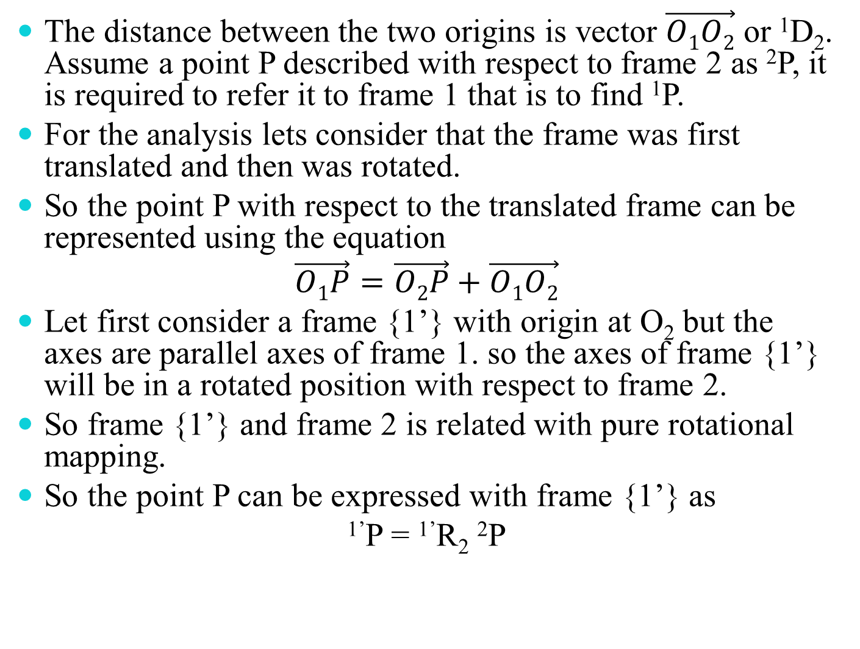
The distance between the two origins is vector $\vec{O1O2}$ or ¹D₂. Assume a point P described with respect to frame 2 as ²P, it is required to refer it to frame 1 that is to find ¹P.
For the analysis lets consider that the frame was first translated and then was rotated.
So the point P with respect to the translated frame can be represented using the equation
$$\vec{O1P}=\vec{O2P}+\vec{O1O2}$$
Let first consider a frame {1’} with origin at O₂ but the axes are parallel axes of frame 1. so the axes of frame {1’} will be in a rotated position with respect to frame 2.
So frame {1’} and frame 2 is related with pure rotational mapping.
So the point P can be expressed with frame {1’} as
^{1’}P = ^{1’}R₂ ²P

Slide 21
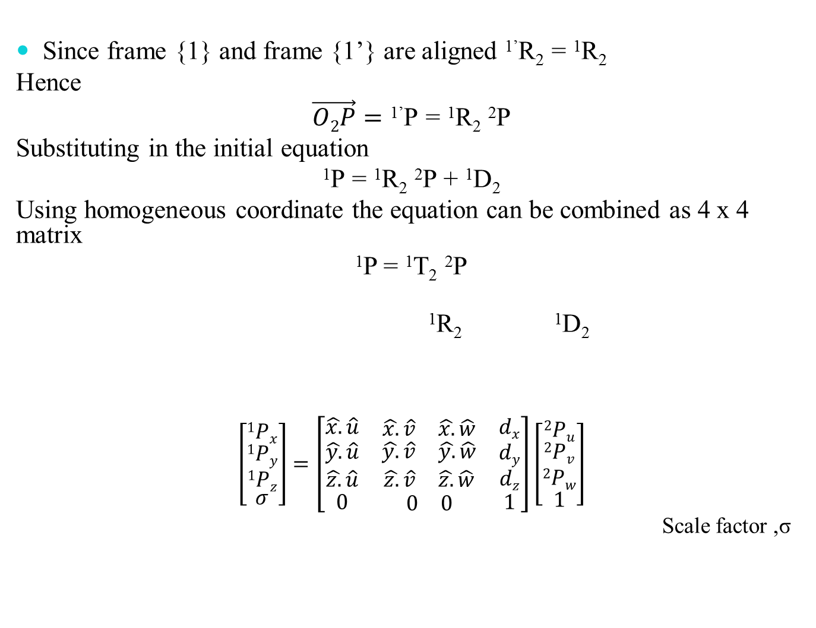
Since frame {1} and frame {1’} are aligned ^{1’}R₂ = ¹R₂
Hence
$$\vec{O2P}=\text{1’}\text{P}\text{ = 1}\text{R}\text{2} \text{2}\text{P}$$
Substituting in the initial equation
$$\text{1}\text{P}\text{ = 1}\text{R}\text{2} \text{2}\text{P}\text{ + 1}\text{D}\text{2}$$
Using homogeneous coordinate the equation can be combined as 4 x 4 matrix
¹P = ¹T₂ ²P
$\text{1}\text{R}\text{2} \text{1}\text{D}\text{2}$
$$\left[\begin{matrix}1Px \\ \begin{matrix}1Py \\ 1Pz\end{matrix} \\ σ\end{matrix}\right]=\left[\begin{matrix}\hat{x.}\hat{u} & \begin{matrix}\hat{x.}\hat{v} & \hat{x.}\hat{w}\end{matrix} & dx \\ \begin{matrix}\hat{y.}\hat{u} \\ \hat{z.}\hat{u}\end{matrix} & \begin{matrix}\begin{matrix}\hat{y.}\hat{v} & \hat{y.}\hat{w}\end{matrix} \\ \begin{matrix}\hat{z.}\hat{v} & \hat{z.}\hat{w}\end{matrix}\end{matrix} & \begin{matrix}dy \\ dz\end{matrix} \\ 0 & \begin{matrix}0 & 0\end{matrix} & 1\end{matrix}\right]\left[\begin{matrix}2Pu \\ \begin{matrix}2Pv \\ 2Pw\end{matrix} \\ 1\end{matrix}\right]$$
Scale factor ,σ

Slide 22
The matrix ¹T₂ can be divide into four parts. The four parts of a generalized homogenous transform T are
Perspective transformation matrix is useful in vision systems and is set to zero vector whenever no perspective view is involved.
In the reverse problem when ¹P is known and ²P is to be found
²P = ²T₁ ¹P
²T₁ = [¹T₂]⁻¹

Slide 23
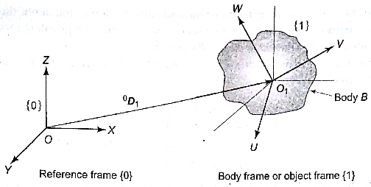
Description of object in space
Location of a object in 3D space is described by both its position and orientation
For specifying a body B in space with respect to frame {0}, a frame {1} with origin O₁ is attached to body B.
Homogeneous transformation matrix ⁰T₁ completely describes the location of body B. ⁰D₁ and ⁰R₁ of ⁰T₁ describes the position and rotation with respect to frame {0} respectively.

Slide 24
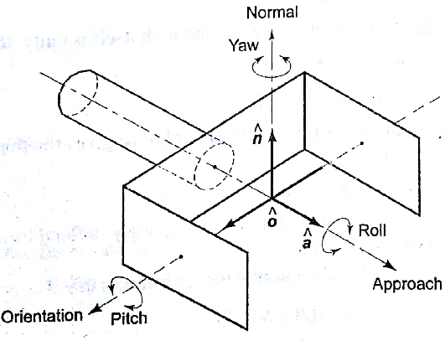
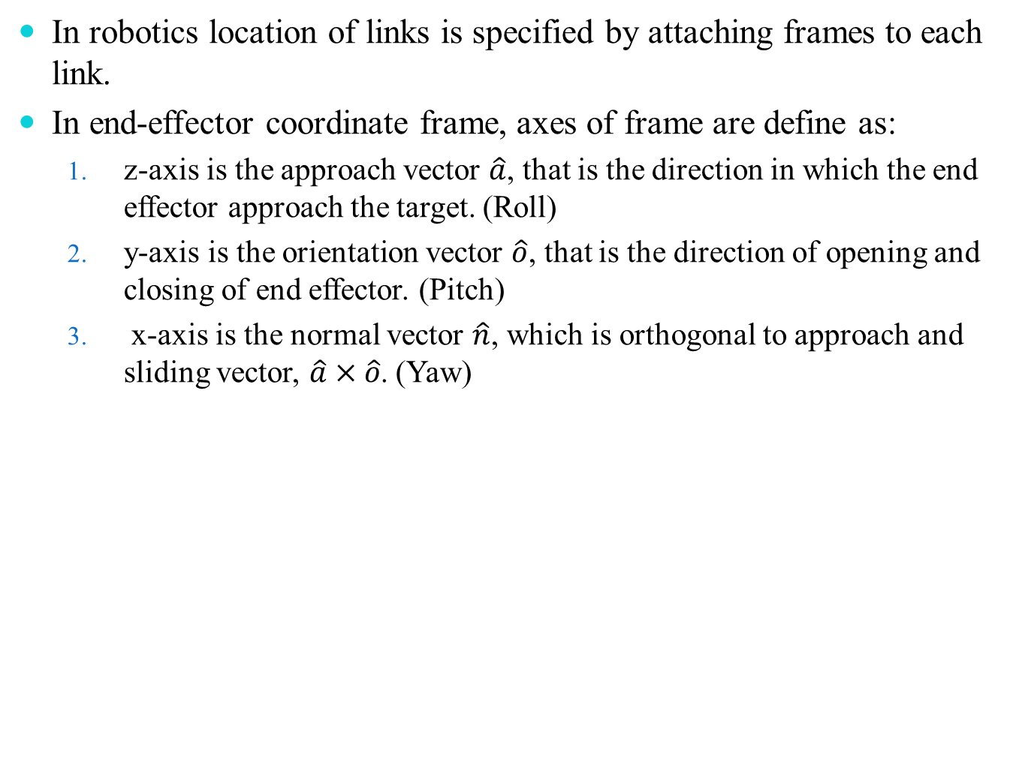
In robotics location of links is specified by attaching frames to each link.
In end-effector coordinate frame, axes of frame are define as:
z-axis is the approach vector $\hat{a}$, that is the direction in which the end effector approach the target. (Roll)
y-axis is the orientation vector $\hat{o}$, that is the direction of opening and closing of end effector. (Pitch)
x-axis is the normal vector $\hat{n}$, which is orthogonal to approach and sliding vector, $\hat{a}×\hat{o}$. (Yaw)

Slide 25
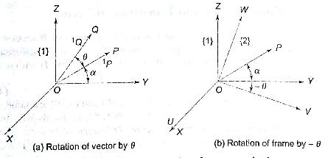
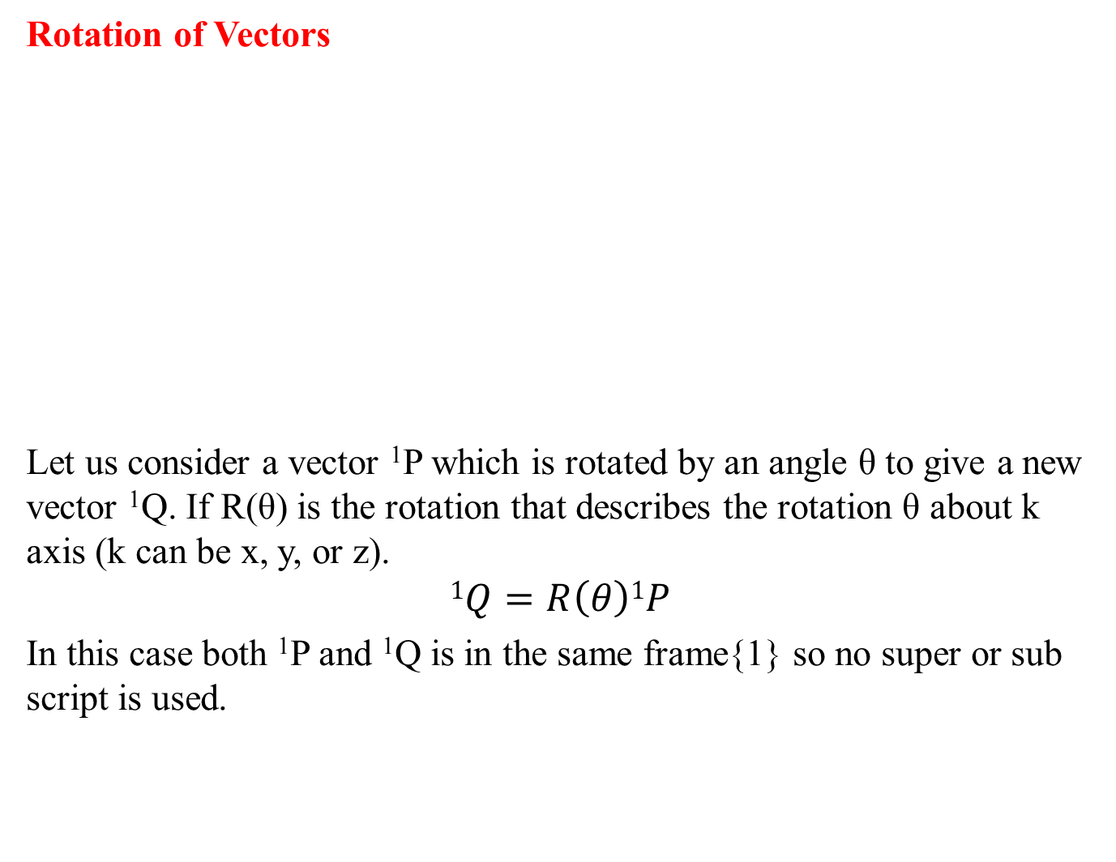
Transformation of vectors
Rotation of Vectors
Let us consider a vector ¹P which is rotated by an angle θ to give a new vector ¹Q. If R(θ) is the rotation that describes the rotation θ about k axis (k can be x, y, or z).
$$1Q=R\left(θ\right)1P$$
In this case both ¹P and ¹Q is in the same frame{1} so no super or sub script is used.

Slide 26
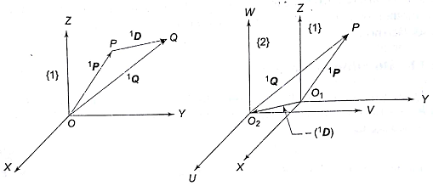
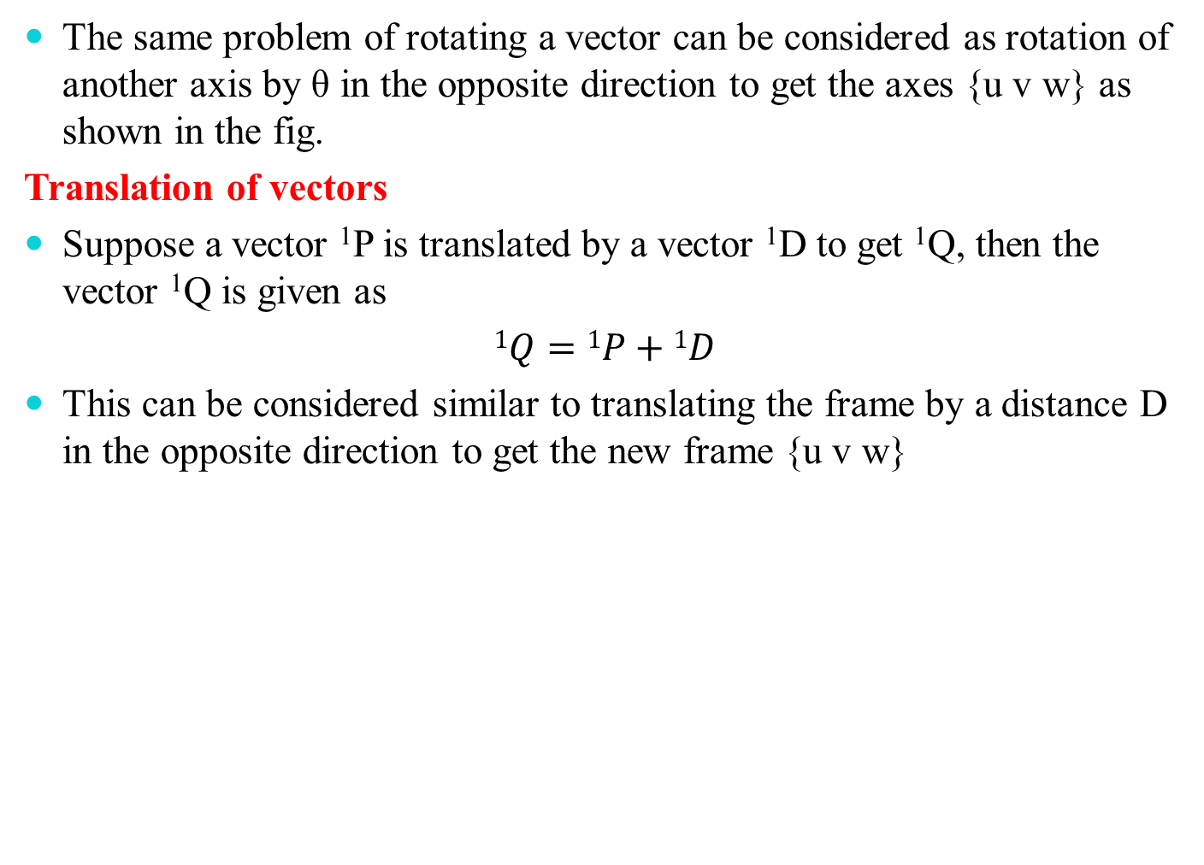
The same problem of rotating a vector can be considered as rotation of another axis by θ in the opposite direction to get the axes {u v w} as shown in the fig.
Translation of vectors
Suppose a vector ¹P is translated by a vector ¹D to get ¹Q, then the vector ¹Q is given as
$1Q=1P+1D$
This can be considered similar to translating the frame by a distance D in the opposite direction to get the new frame {u v w}

Slide 27
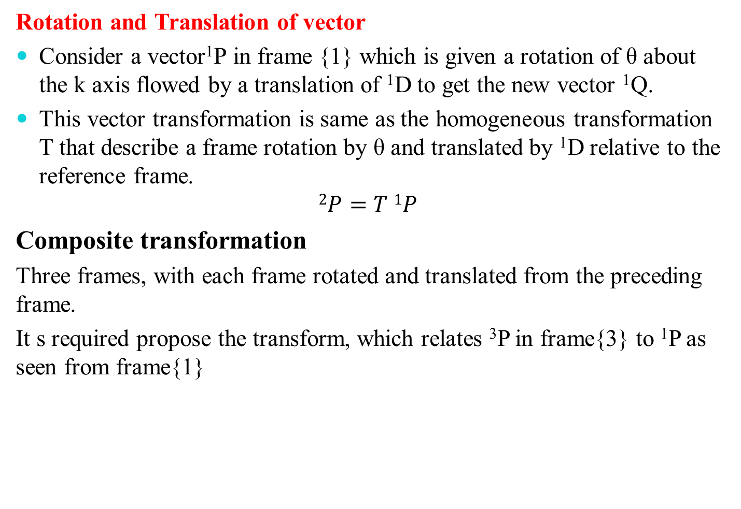
Rotation and Translation of vector
Consider a vector¹P in frame {1} which is given a rotation of θ about the k axis flowed by a translation of ¹D to get the new vector ¹Q.
This vector transformation is same as the homogeneous transformation T that describe a frame rotation by θ and translated by ¹D relative to the reference frame.
$$2P=T 1P$$
Composite transformation
Three frames, with each frame rotated and translated from the preceding frame.
It s required propose the transform, which relates ³P in frame{3} to ¹P as seen from frame{1}

Slide 28
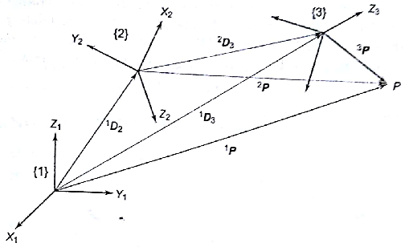
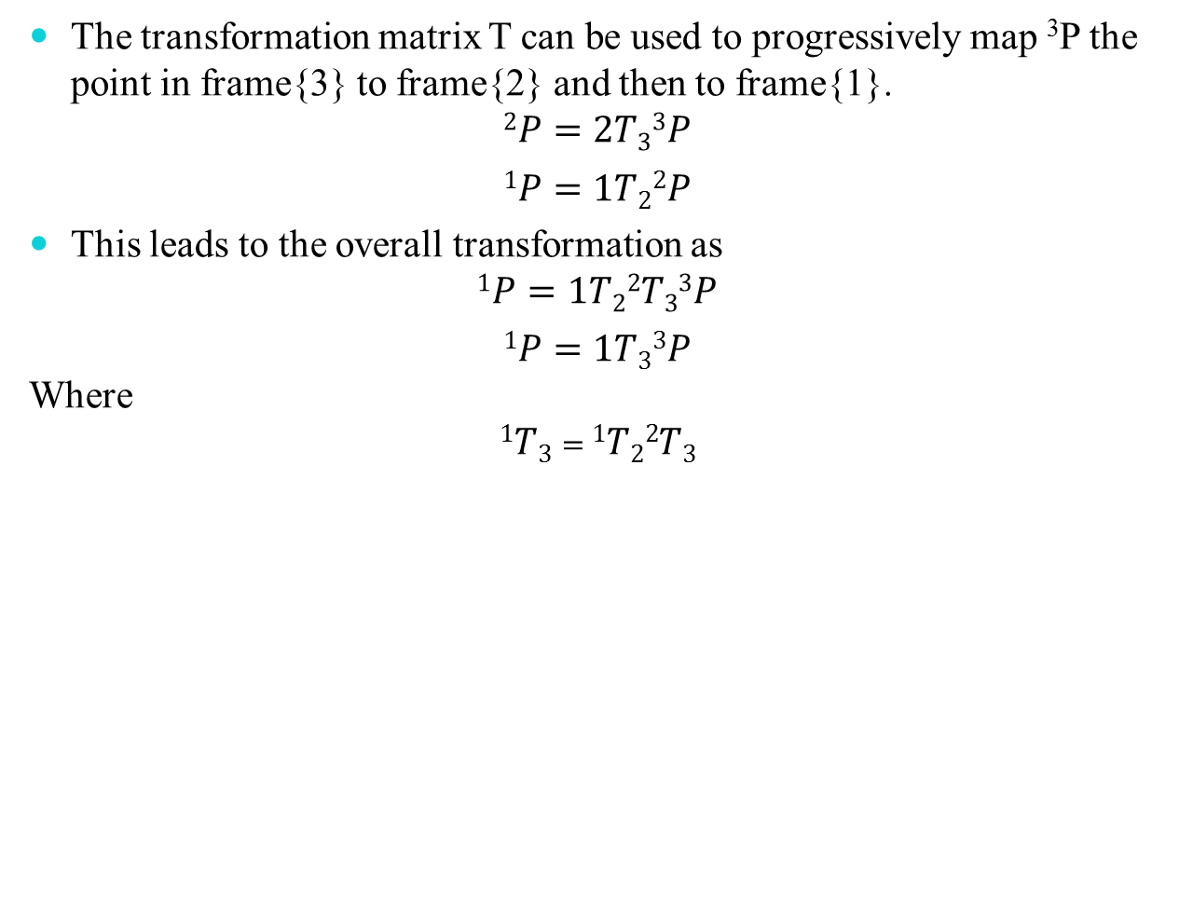
The transformation matrix T can be used to progressively map ³P the point in frame{3} to frame{2} and then to frame{1}.
$$2P=2T33P$$
$$1P=1T22P$$
This leads to the overall transformation as
$$1P=1T22T33P$$
$$1P=1T33P$$
Where
$1T3=$ $1T22T3$

Slide 29
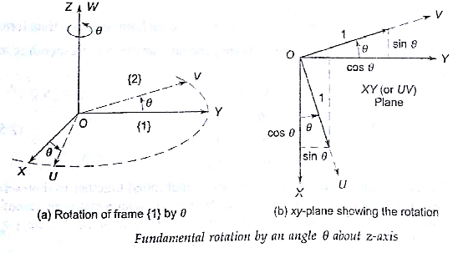
Fundamental rotation matrix
Principal Axes Rotation
To determine the orientation of frame{2}, which is rotated about one of the three principal axes of frame{1}.
Consider the rotation of frame{2} with respect to frame{1} by angle θ about the z axis of frame{1}.

Slide 30
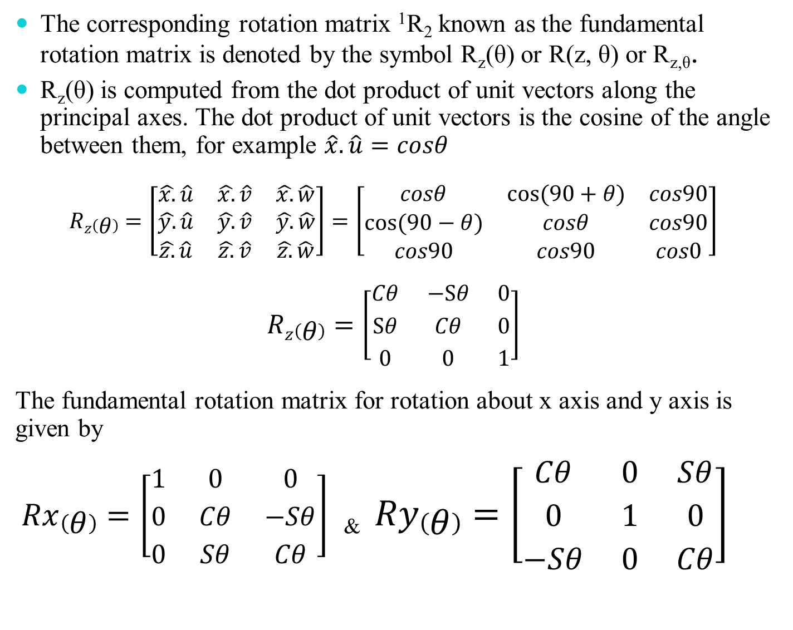
The corresponding rotation matrix ¹R₂ known as the fundamental rotation matrix is denoted by the symbol R_{z}(θ) or R(z, θ) or R_{z,θ}.
R_{z}(θ) is computed from the dot product of unit vectors along the principal axes. The dot product of unit vectors is the cosine of the angle between them, for example $\hat{x}.\hat{u}=cosθ$
$$Rz\left(θ\right)=\left[\begin{matrix}\hat{x.}\hat{u} & \hat{x.}\hat{v} & \hat{x.}\hat{w} \\ \hat{y.}\hat{u} & \hat{y.}\hat{v} & \hat{y.}\hat{w} \\ \hat{z.}\hat{u} & \hat{z.}\hat{v} & \hat{z.}\hat{w}\end{matrix}\right]=\left[\begin{matrix}cosθ & cos⁡(90+θ) & cos90 \\ cos⁡(90−θ) & cosθ & cos90 \\ cos90 & cos90 & cos0\end{matrix}\right]$$
$$Rz\left(θ\right)=\left[\begin{matrix}Cθ & −Sθ & 0 \\ Sθ & Cθ & 0 \\ 0 & 0 & 1\end{matrix}\right]$$
The fundamental rotation matrix for rotation about x axis and y axis is given by
$Rx\left(θ\right)=\left[\begin{matrix}1 & 0 & 0 \\ 0 & Cθ & −Sθ \\ 0 & Sθ & Cθ\end{matrix}\right]$ & $Ry\left(θ\right)=\left[\begin{matrix}Cθ & 0 & Sθ \\ 0 & 1 & 0 \\ −Sθ & 0 & Cθ\end{matrix}\right]$

Slide 31
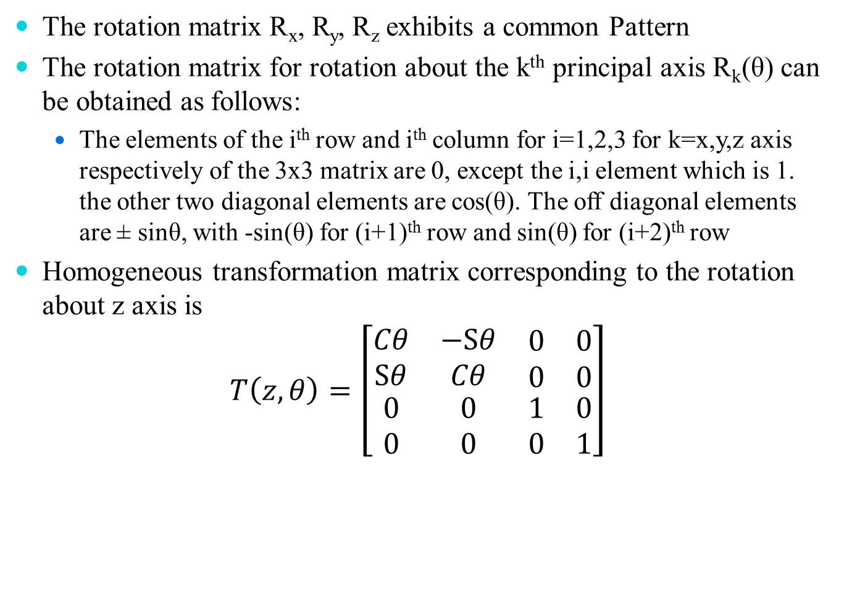
The rotation matrix R_{x}, R_{y}, R_{z} exhibits a common Pattern
The rotation matrix for rotation about the k^{th} principal axis R_{k}(θ) can be obtained as follows:
The elements of the i^{th} row and i^{th} column for i=1,2,3 for k=x,y,z axis respectively of the 3x3 matrix are 0, except the i,i element which is 1. the other two diagonal elements are cos(θ). The off diagonal elements are ± sinθ, with -sin(θ) for (i+1)^{th} row and sin(θ) for (i+2)^{th} row
Homogeneous transformation matrix corresponding to the rotation about z axis is
$$T\left(z,θ\right)=\left[\begin{matrix}Cθ & −Sθ & \begin{matrix}0 & 0\end{matrix} \\ Sθ & Cθ & \begin{matrix}0 & 0\end{matrix} \\ \begin{matrix}0 \\ 0\end{matrix} & \begin{matrix}0 \\ 0\end{matrix} & \begin{matrix}\begin{matrix}1 & 0\end{matrix} \\ \begin{matrix}0 & 1\end{matrix}\end{matrix}\end{matrix}\right]$$

Slide 32
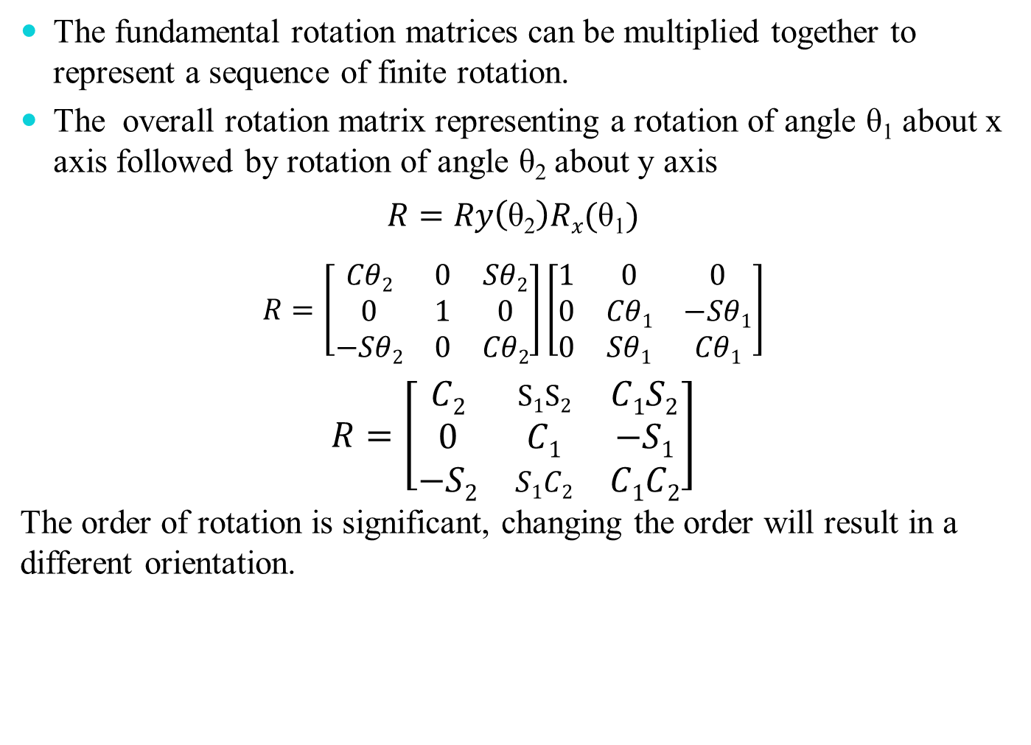
The fundamental rotation matrices can be multiplied together to represent a sequence of finite rotation.
The overall rotation matrix representing a rotation of angle θ₁ about x axis followed by rotation of angle θ₂ about y axis
$$R=Ry\left(\text{θ}\text{2}\right)Rx(\text{θ}\text{1})$$
$$R=\left[\begin{matrix}Cθ2 & 0 & Sθ2 \\ 0 & 1 & 0 \\ −Sθ2 & 0 & Cθ2\end{matrix}\right]\left[\begin{matrix}1 & 0 & 0 \\ 0 & Cθ1 & −Sθ1 \\ 0 & Sθ1 & Cθ1\end{matrix}\right]$$
$$R=\left[\begin{matrix}C2 & S1S2 & C1S2 \\ 0 & C1 & −S1 \\ −S2 & S1C2 & C1C2\end{matrix}\right]$$
The order of rotation is significant, changing the order will result in a different orientation.

Slide 33
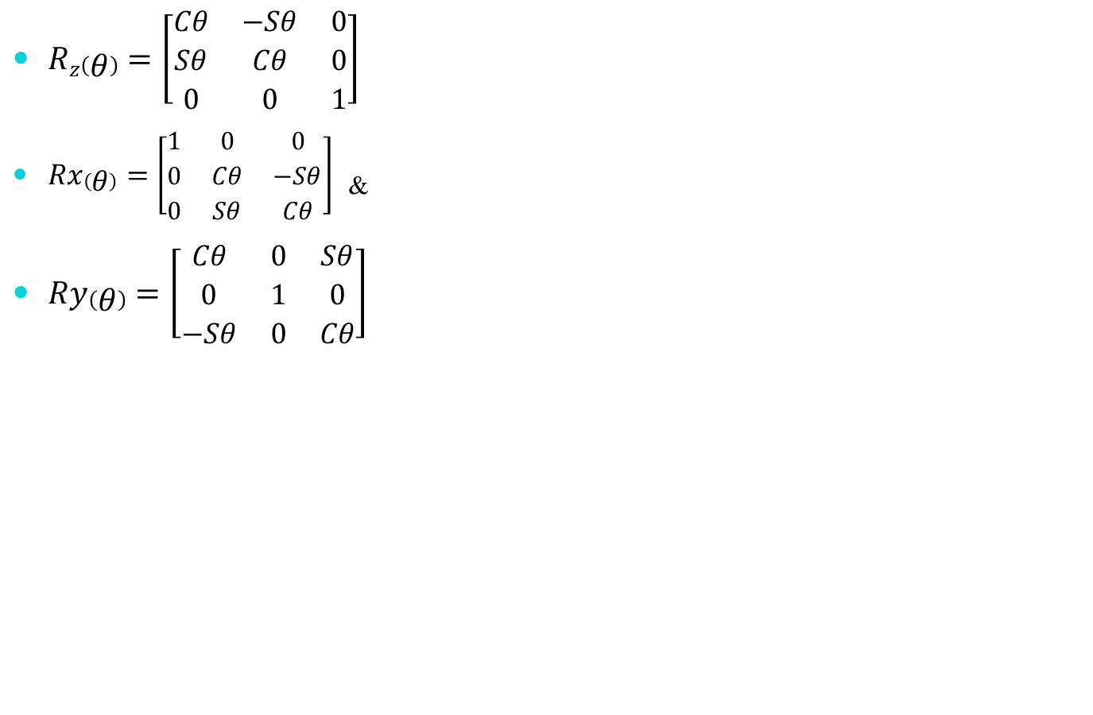
$Rz\left(θ\right)=\left[\begin{matrix}Cθ & −Sθ & 0 \\ Sθ & Cθ & 0 \\ 0 & 0 & 1\end{matrix}\right]$
$Rx\left(θ\right)=\left[\begin{matrix}1 & 0 & 0 \\ 0 & Cθ & −Sθ \\ 0 & Sθ & Cθ\end{matrix}\right]$ &
$Ry\left(θ\right)=\left[\begin{matrix}Cθ & 0 & Sθ \\ 0 & 1 & 0 \\ −Sθ & 0 & Cθ\end{matrix}\right]$
 | 0 | 30 | 45 | 60 | 90
sin | 0 | 1/2 | 1/√2 | √3/2 | 1
cos | 1 | √3/2 | 1/√2 | 1/2 | 0

Slide 34
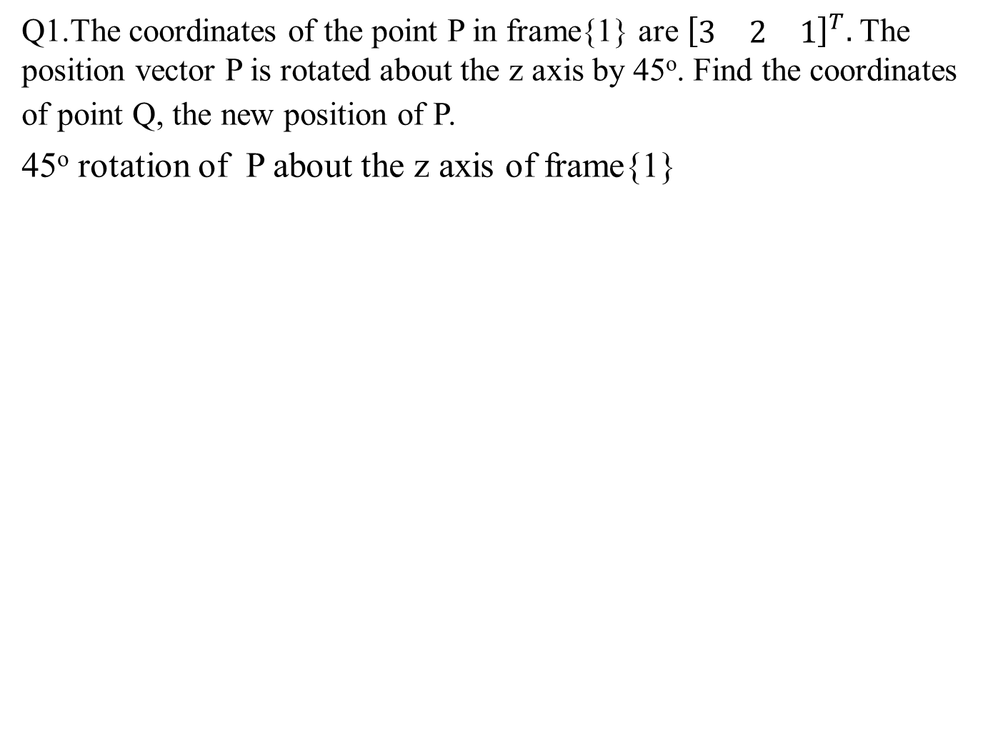
Q1.The coordinates of the point P in frame{1} are ${\left[\begin{matrix}3 & 2 & 1\end{matrix}\right]}^{T}.$ The position vector P is rotated about the z axis by 45º. Find the coordinates of point Q, the new position of P.
45º rotation of P about the z axis of frame{1}

Slide 35
Q2.

Slide 37
Q3.

Slide 38
Q4.

Slide 40
Direct Kinematic model
In a robotic manipulator the tool or end effector is required to follow a planned trajectory to manipulate objects or carry out the task in the workspace, which require control of position of each link and joint of the manipulator to control the position and orientation of the tool.
Kinematical model describes the spatial positioning of joints and links and position and orientation of the end effector.

Slide 41
Mechanical structure and notation
A manipulator consists of a chain of rigid bodies, called links, connected to each other by joints, which allow linear or revolute motion between connected links each of which exhibits just one degree of freedom (DOF).
The number of degrees of freedom a manipulator possesses is the number of independent parameters required to completely specify its position and orientation in space.
Because each joint has only one degree of freedom, the degrees of freedom of a manipulator are equal to number of joints.
Joints between links of a manipulator can be classified as revolute or prismatic.
A revolute joint, denoted as R -joint, allows rotational motion between connected links. A prismatic joint, denoted as P-joint, also known as sliding or rectilinear joint, permits translational motion between the connected links.

Slide 42
Each joint has a joint axis with respect to which, the motion of joint is described
In the case of revolute joints, the axis of relative rotation is the joint axis. For the prismatic joint, the axis of relative translational motion is the joint axis. By convention,
The z-axis of a coordinate frame is aligned with the joint axis.

Slide 43
The links of a manipulator are numbered outwardly starting from the immobile base as link 0, first moving body as link 1, to the last link out to the free end as link n. Link n is the "tool" or "end-effector".
The joints are numbered, with joint 1 between link 0 and link 1 and so on, out to the joint n between link (n-1) and link n.
An n-DOF manipulator arm consists of (n+1) links (including link 0) connected by n joints.

Slide 44
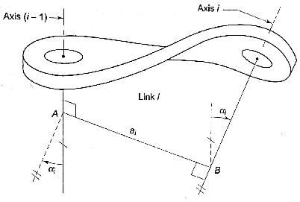
Description of links and joints
A robotic manipulator is modelled as a chain of rigid links interconnected by revolute and/or prismatic joints.
To describe the position and orientation of a link in space, a coordinate frame is attached to each link, namely, frame {i} to link i..
The position and orientation of frame {i}, relative to previous frame {i-1}, can be described by a homogeneous transformation matrix.

Slide 45
LINK PARAMETERS
Figure shows link i of a manipulator with associated joint axes (i-1) and {i}.
From a geometric viewpoint, the link defines the relative position and orientation of joint axes at its two ends.
For the two axes (i-1) and axis i there exist a mutual perpendicular, which gives the shortest distance between the two axes. This shortest distance along the common normal is defined the link length and is denoted as a_{i}.
The angle between the projection of axis (i-1) and axis i, on a plane perpendicular to the common normal AB, is known as the link twist and is denoted by α_{i}
These two parameters, a_{i} and α_{i} are known as link parameters and are constant for a given link.
For industrial robots, the links are usually straight, that is, the two joint axes are parallel, giving link length equal to physical link dimension and link twist equal to zero.

Slide 46
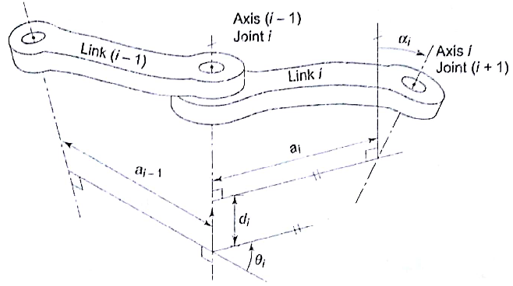
JOINT PARAMETERS
For two links connected by either a revolute or a prismatic joint, the relative position of these links is measured by the displacement at the joint, which is either joint distance or joint angle, depending on the type of joint.
Joint distance (d_{i}) is the perpendicular distance between the two adjacent common normals a_{i-1} and a_{i} measured along axis (i-1).

Slide 47
In other words, joint distance is the translation needed along joint axis (i-1) to make a_{i-1}intersect with a_{i}.
Joint angle (θ₁) is the angle between the two adjacent common normals a_{i-1} and a_{i}, measured in right-handed direction about the axis (i-1).
It is the rotation about joint axis (i-1) needed to make a_{i-1} parallel to a_{i}. These two parameters are called joint parameters
A 1-DOF joint requires only one variable to describe its position.
Thus, for every 1 -DOF joint, it will always be the case that one of the two joint parameters (θ_{i} and d_{i}) is fixed and the other is a variable.
The displacement of a joint is measured by either angle θ_{i} or distance d_{i} depending on the type of joint.

Slide 48
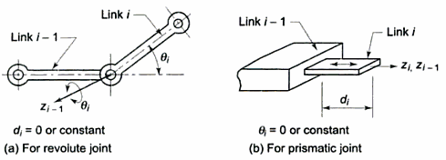
For a revolute joint, d_{i} is zero or constant and θ_{i}; varies, while for a prismatic joint θ_{i} is zero or constant and d_{i} varies, describing the relative position of links.
The varying parameter is known as joint variable
A generalized parameter q is used to denote the joint displacement (variable) of either type of joint. The generalized joint displacement variable is defined as

Slide 49
KINEMATIC MODELING OF THE MANIPULATOR
This model is the analytical description of the spatial geometry of motion of the manipulator with respect to a fixed (inertial) reference frame, as a function of time.
The kinematic modeling problem is split into two problems as:
Given the set of joint-link parameters, the problem of finding the position and orientation of the end-effector with respect to a known (immobile or inertial) reference frame for an n-DOF manipulator. This is referred to as direct (or forward) kinematic model or direct kinematics. This model gives the position and orientation of the end-effector as a function of the joint variables and other joint-link constant parameters.
For a given position and orientation of the end-effector (of the n-DOF manipulator), with respect to an immobile or inertial reference frame, it is required to find a set of joint variables that would bring the end-effector in the specified position and orientation. This is the second problem and is referred to as the inverse kinematic model or inverse kinematics.

Slide 50
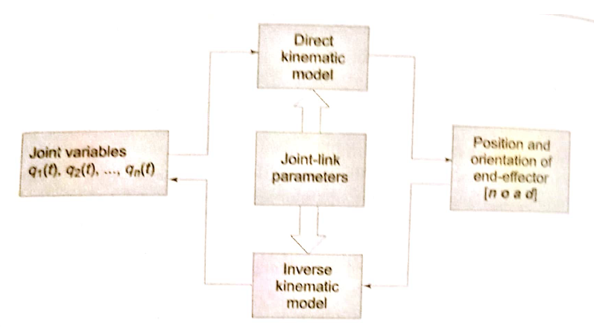
Direct and Kinematic model

Slide 51
Denavit-Hartenberg (DH) notation
For kinematic modeling, frames are assigned to each link of the manipulator starting from the base to the end-effector.
The homogeneous transformation matrices relating the frames attached to successive links describe the spatial relationship between adjacent links.
The composition of these individual transform matrices determines the overall transform matrix, describing tool frame with respect to base frame.
The definition of a manipulator with four joint-link parameters (a_{i}, α_{i}, d_{i}, θ_{i}) for each link and a systematic procedure for assigning right-handed orthonormal coordinate frames, one to each link in an open kinematic chain, was proposed by Denavit and Hartenberg (1955) and is known as Denavit-Hartenberg (DH) notation

Slide 52
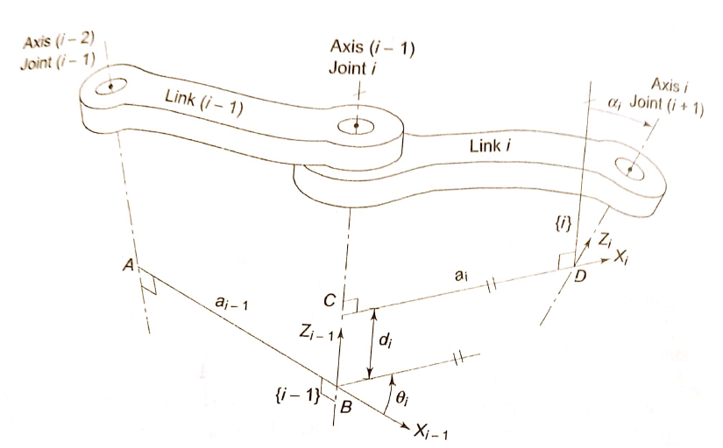

Slide 53
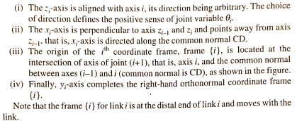
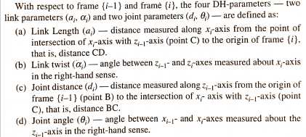

Slide 54
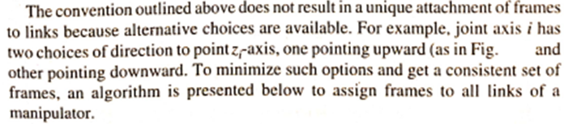

Slide 55
Link Frame Assignment
This algorithm assigns frames and determines the DH-parametcrs for each link of an n-DOF manipulator.
The displacement of each joint-link is measured with respect to a frame.
Therefore the zero position of each link needs to be clearly defined.
The zero position for a revolute joint is when the joint angle θ is zero. while for a prismatic joint it is when the joint displacement is minimal; it may or may not be zero. When all the joints are in zero position, the manipulator is said to be in home position.
Before assigning frames, the zero position of each joint, that is. the home position of the manipulator must be decided. The frames are then assigned imagining the manipulator in home position.

Slide 56
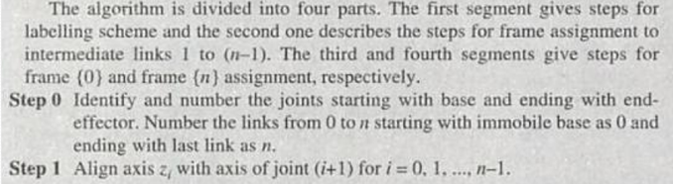
D-H Algorithm

Slide 57
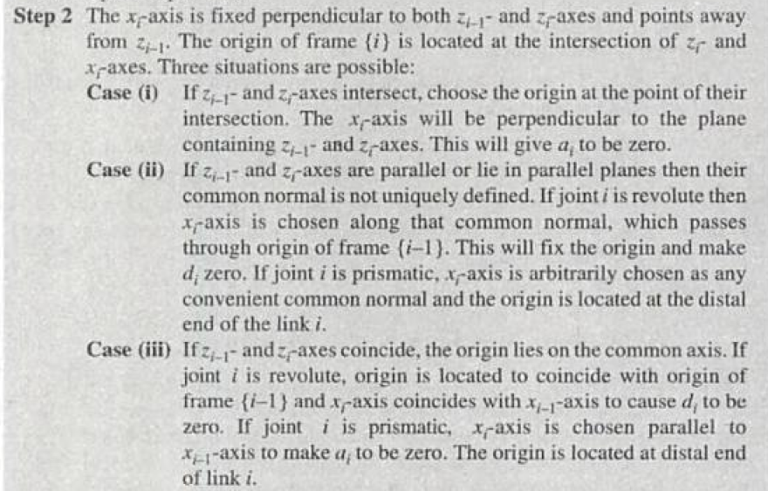

Slide 58
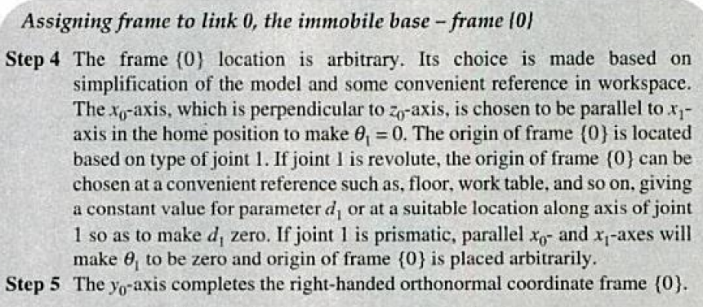

Slide 59
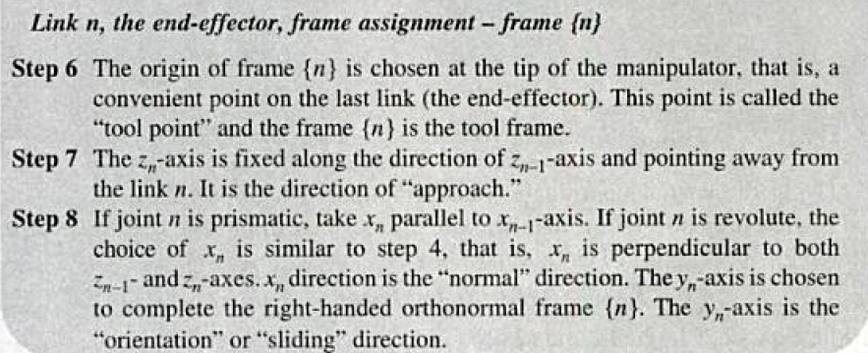

Slide 60
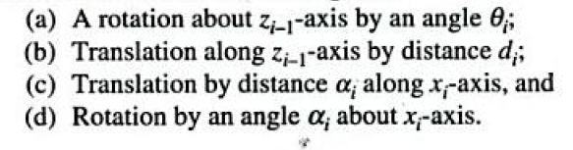

Slide 61
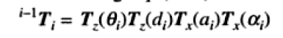
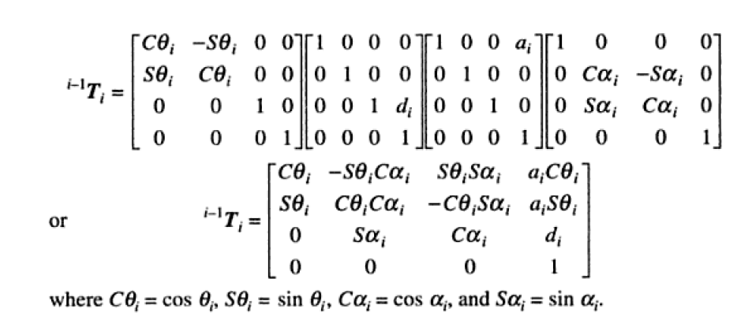

Slide 62
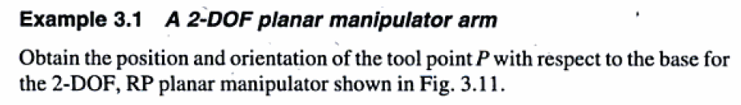
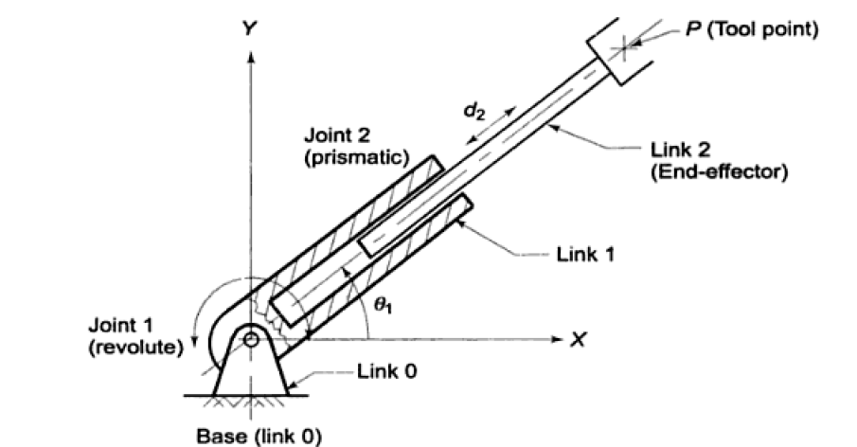

Slide 63
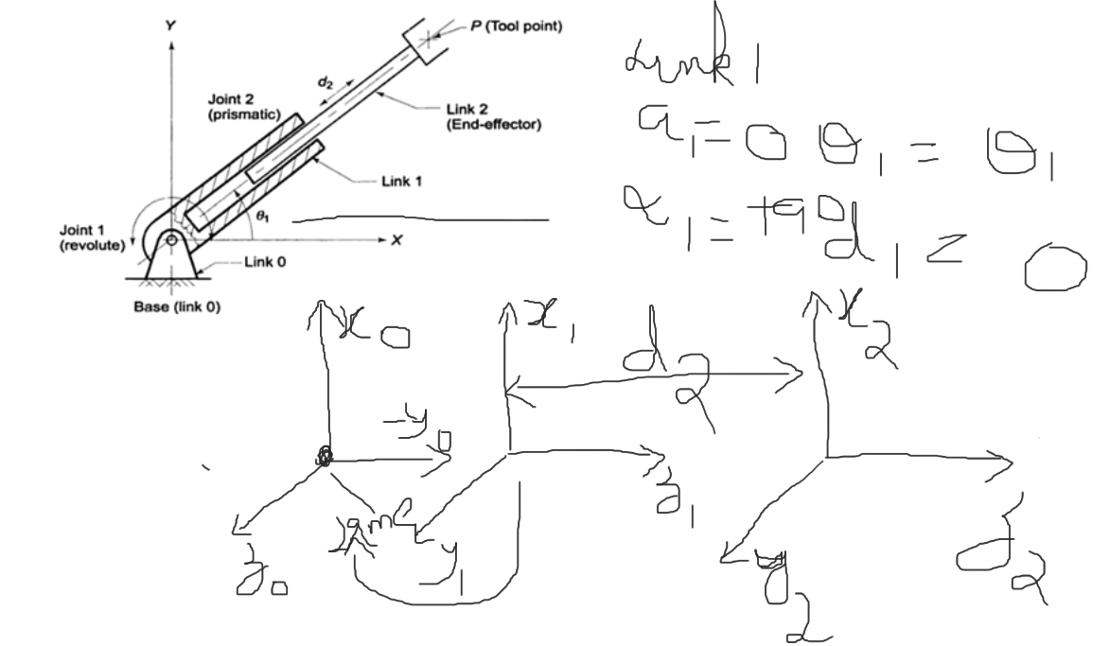

Slide 64


Solution

Slide 65




Slide 66



Slide 67


